Slide 1

Slide 1
BUAN 6340.001 - Programming for Data Science - S24
Flight Delays and Cancellations
Under the guidance of
Prof. Jason Parker
Amol Sanjay Bhadane
NetID: ASB220006
Date: 04-24-2024

Slide 2
Introduction
Objective: To predict flight delays and cancellations using historical data to improve airline operational efficiency and customer satisfaction.
Challenge: Flight delays and cancellations are a major issue affecting millions of passengers and causing significant economic losses.
Impact: Delays and cancellations not only affect passenger plans but also disrupt airline operations and increase costs.

Slide 3
Data overview
Data Source: 2015 flight data from the U.S. Department of Transportation.
Data Attributes :
There are 3 files having airlines, airport and flight details respectively.
The number of columns are 40 with flights.csv file having 1048576 records.
Dataset Features:
Records from over 5.8 million flights
31 attributes including airline, flight numbers, scheduled and actual departure/arrival times, delay durations, etc.
Tools Used:
Python, Pandas for data manipulation
Matplotlib and Seaborn for visualization
Scikit-Learn for predictive modeling.

Slide 4
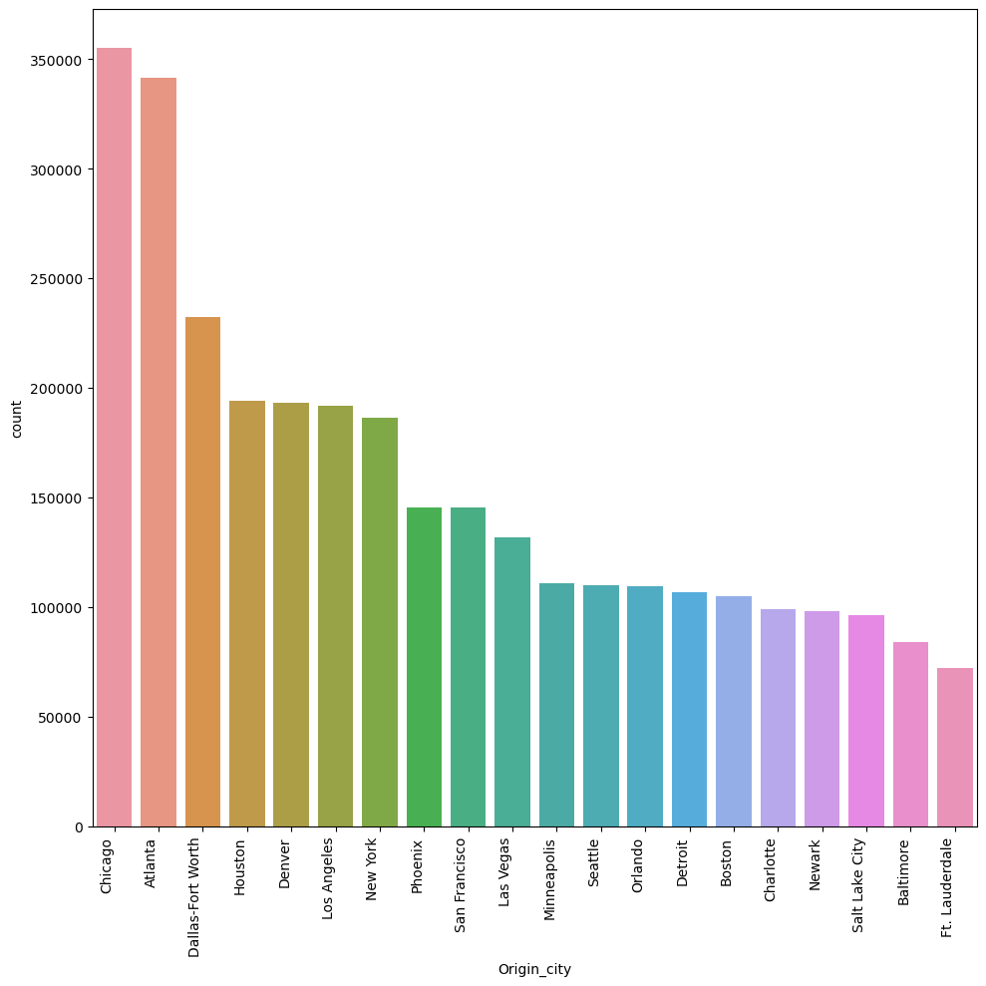
Exploratory Data Analysis
Finding shows that Chicago and Atlanta has the highest count of flight from origin city

Slide 5
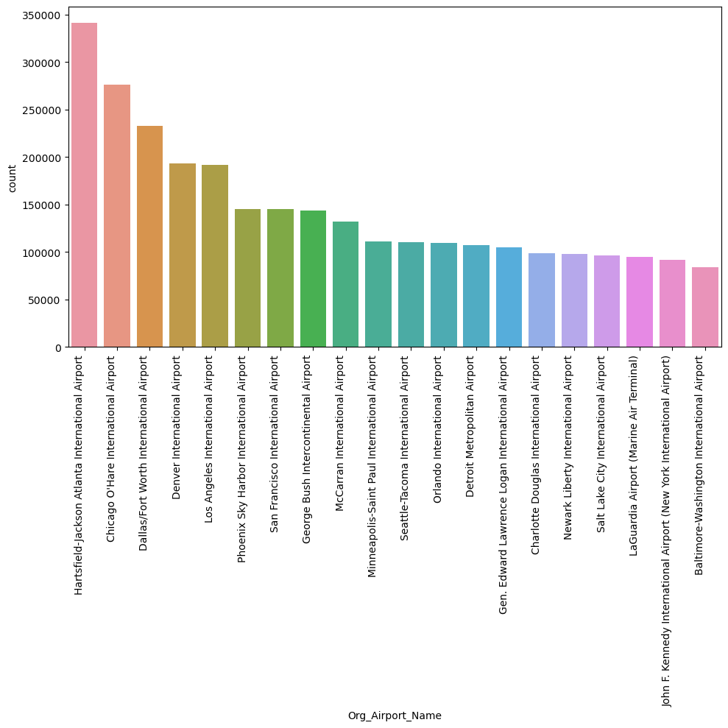
Exploratory Data Analysis
Finding shows that Chicago and Atlanta has the highest count of flight from origin city

Slide 6
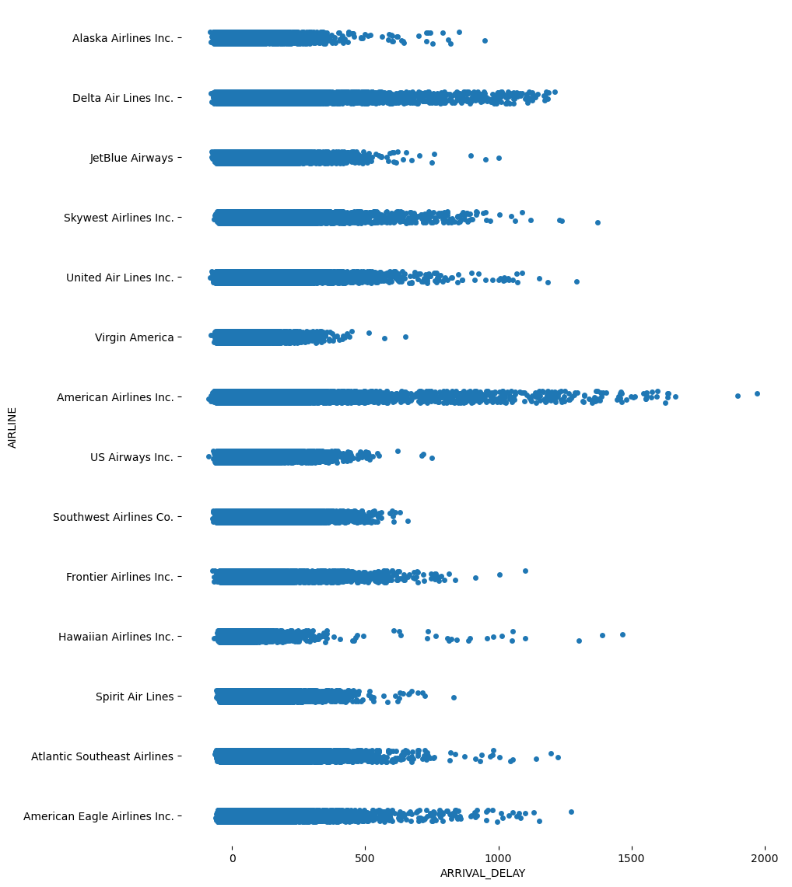
Exploratory Data Analysis
American Airlines Inc has the highest Arrival Delay.

Slide 7
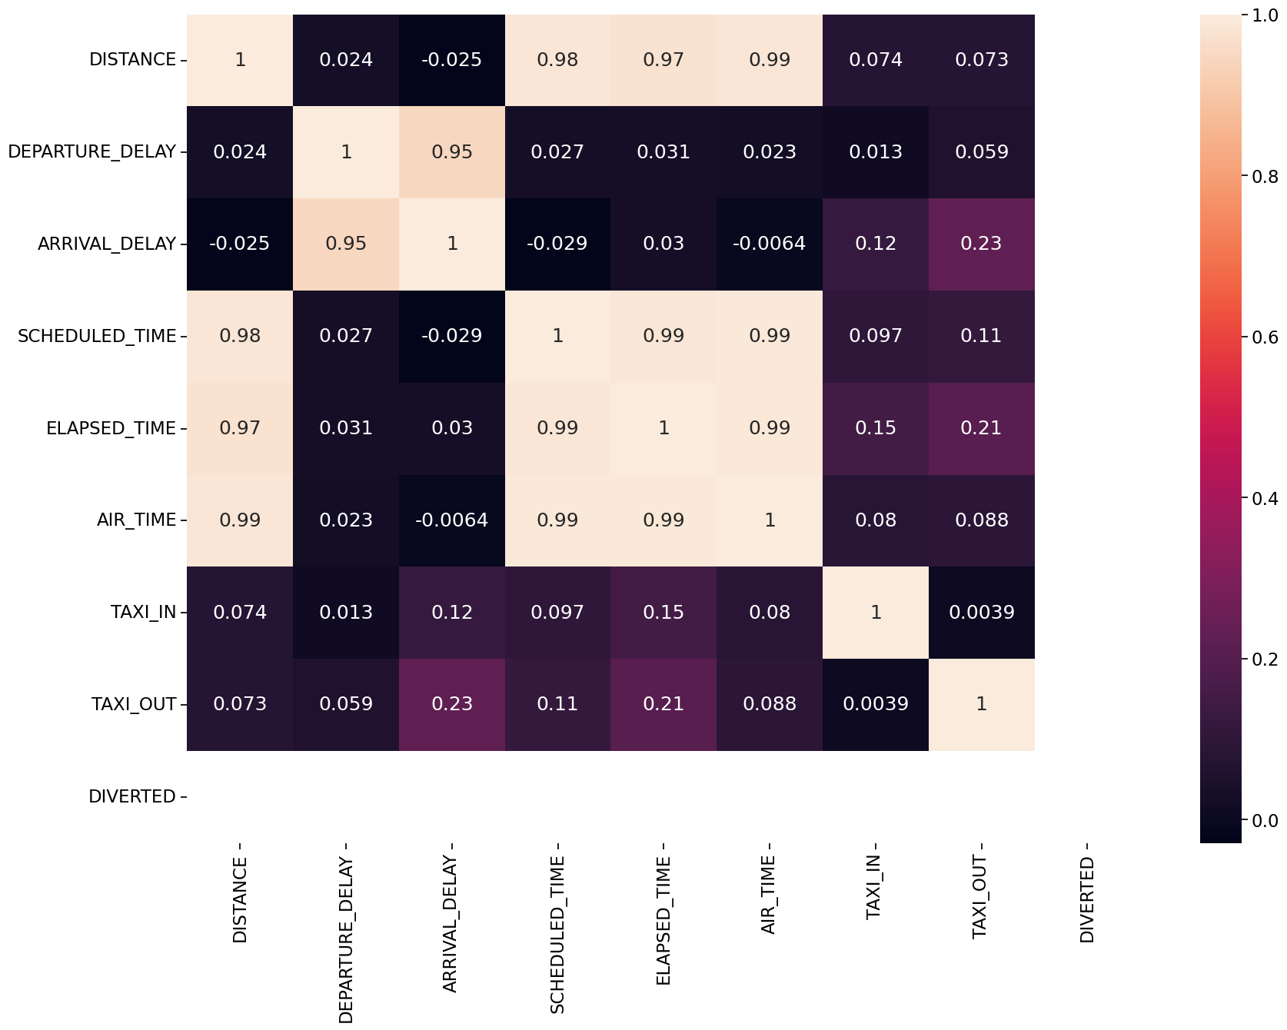
Exploratory Data Analysis
Very High Correlation Between Arrival Delay and Departure Delay
It shows that maximum of the Arrival Delays are due to the Departure Delays but some flights has still arrived on time even after departed late from the Origin Airport. Now we need to check why departure Delay is happening in the origin Airport Which may be due to security Delays, Air System Delays etc.

Slide 8
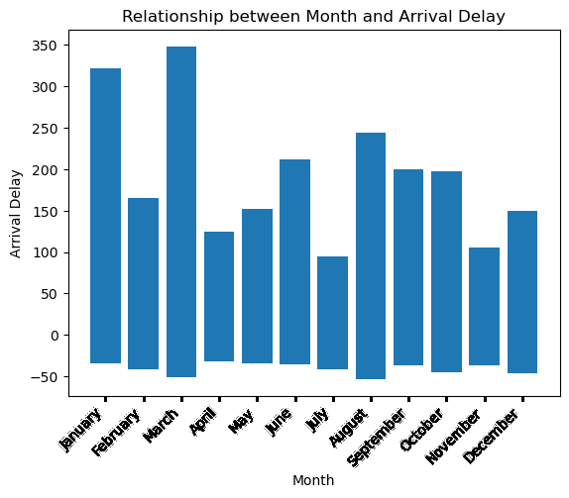
Exploratory Data Analysis
Observation:
January and March are the top two months facing delays. On the other hand, July is the lowest.

Slide 9
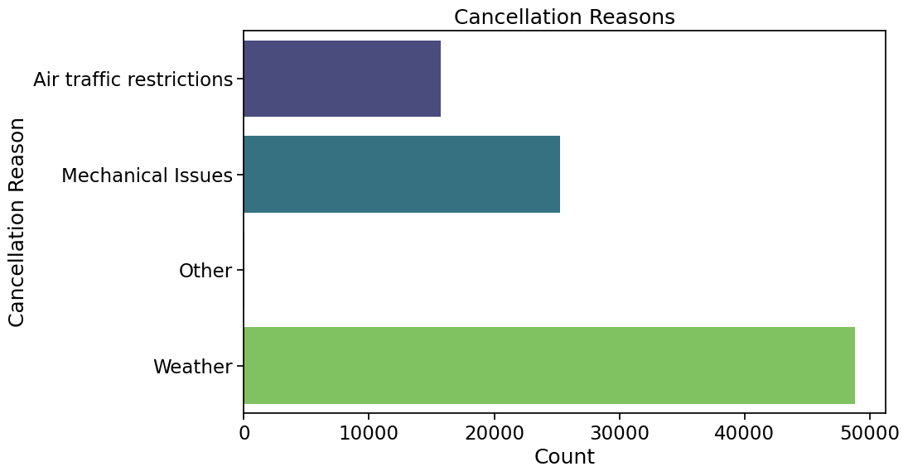
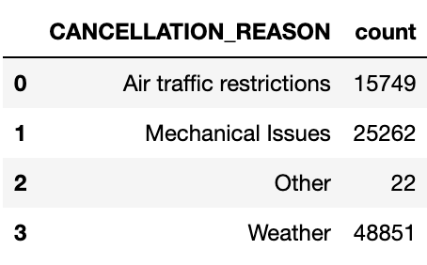
Exploratory Data Analysis
Observation:
The weather is the top reason for cancellations.

Slide 10
Modeling Techniques
Trained and evaluate multiple regression models on the same dataset, using various performance metrics such as Mean Absolute Error, Mean Squared Error, Root Mean Squared Error, and R-squared score. By iterating over the list of models and their corresponding names, to compare the performance of different models
Different models trained: Lasso', 'Linear Regression', 'Ridge', 'Random forest Regressor', 'Decision Tree Regressor', 'Boosted Linear', 'Boosted Lasso', 'Boosted Ridge', 'Bagged Linear', 'Bagged Lasso', 'Bagged Ridge'

Slide 11
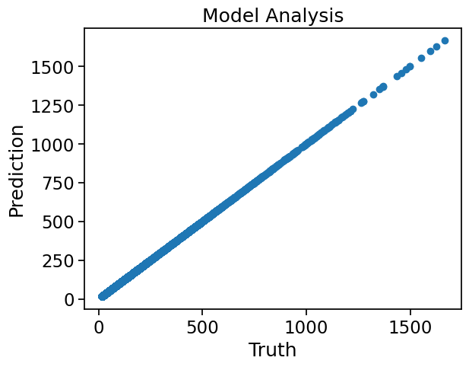
Model fitting and results
Linear Regression
Mean Absolute Error: 1.6714642909805332e-12
Mean Squared Error: 4.71887448868712e-24
Root Mean Squared Error: 2.172297053509745e-12
R2 : 1.0
Boosted Linear
Mean Absolute Error: 9.898710848160486e-13
Mean Squared Error: 2.5269767860980313e-24
Root Mean Squared Error: 1.5896467488401413e-12
R2 : 1.0

Slide 12
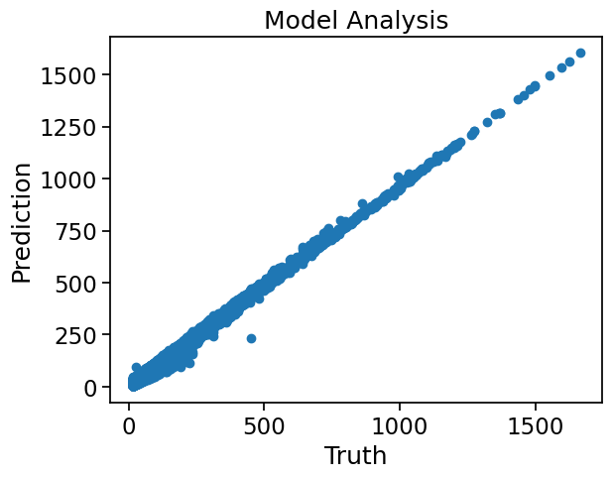
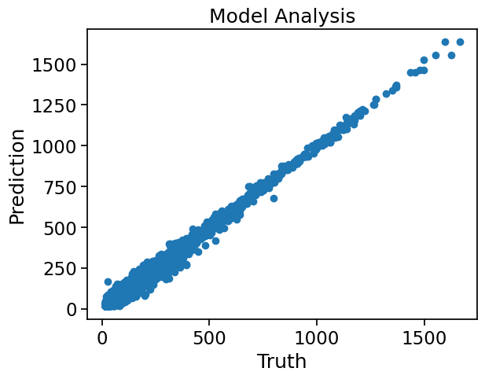
Model fitting and results
Lasso
Mean Absolute Error: 4.067457537318274
Mean Squared Error: 31.712789049439767
Root Mean Squared Error: 5.631410928838329
R2 : 0.9922421930546694
Random forest Regressor
Mean Absolute Error: 0.7785049775571102
Mean Squared Error: 12.243906567366283
Root Mean Squared Error: 3.4991294013463237
R2 : 0.9970048089034929

Slide 13
Conclusion
The analysis confirmed that arrival delays are primarily caused by departure delays, highlighting their significant impact within the aviation industry, with root causes ranging from security delays and airline system inefficiencies to broader airline operational delays.
January and March emerge as the primary months experiencing significant delays. Conversely, July exhibits the lowest occurrence of delays.
Weather emerges as the primary reason for cancellations. And Air traffic restrictions represent the least prevalent cause of cancellations reasons.
These delays not only impact customer satisfaction but also significantly affect the profitability of airlines. Reducing these delays is crucial for enhancing customer experience and improving the financial health of the industry.

Slide 14

Slide 10
THANK YOU

